Slide 1



Neural Networks Feed Forward Networks
Indian Institute of Information Technology, Allahabad
By
Dr. Shiv Ram Dubey Assistant Professor Computer Vision And Biometrics Lab (CVBL) Department Of Information Technology Indian Institute Of Information Technology, Allahabad
Email: srdubey@iiita.ac.in Web: https://profile.iiita.ac.in/srdubey/

Slide 2
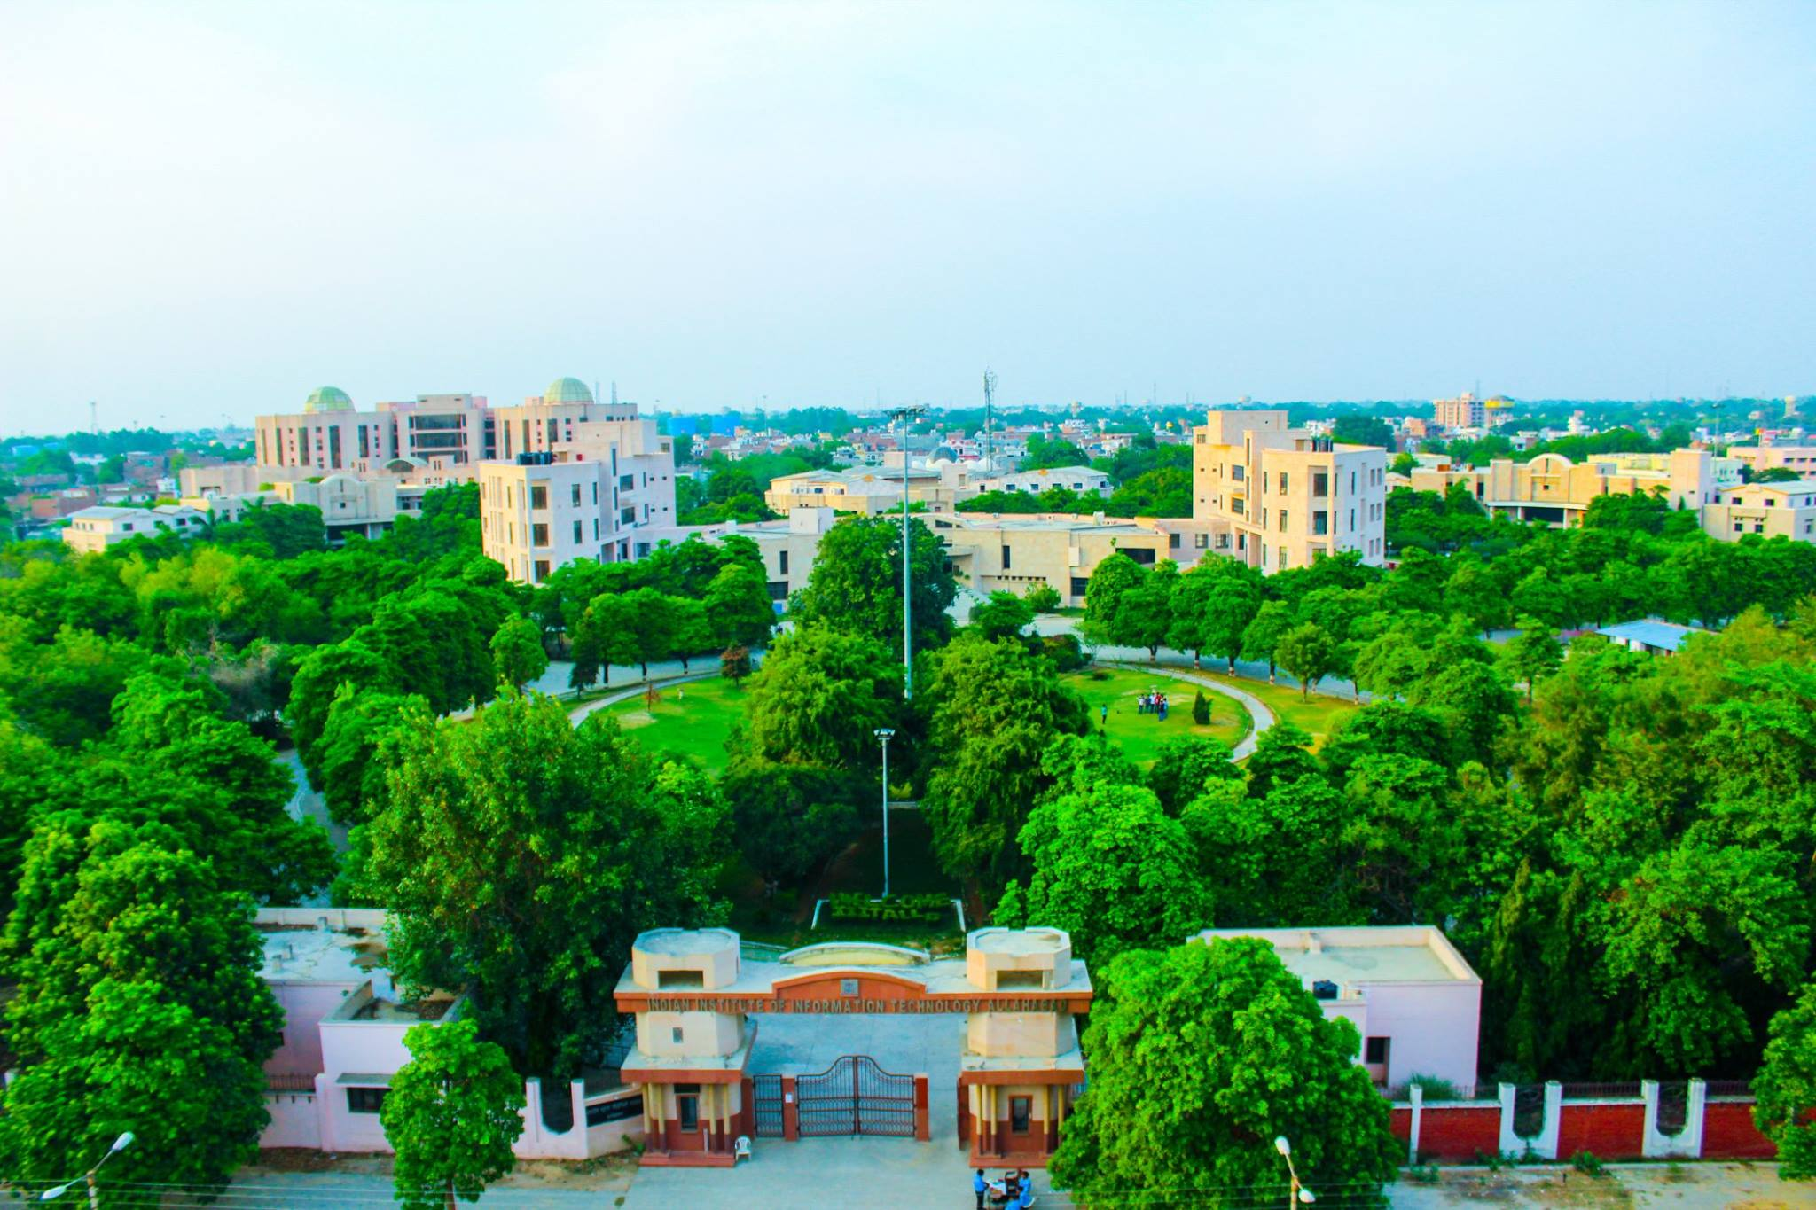
About IIIT Allahabad (A Research Led Institute of National Importance)

Slide 3
Disclaimer
The content (text, image, and graphics) used in this slide are adopted from many sources for Academic purposes. Broadly, the sources have been given due credit appropriately. However, there is a chance of missing out some original primary sources. The authors of this material do not claim any copyright of such material.

Slide 4

Image categorization / CLASSIFICATION

Slide 5
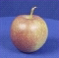
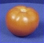
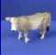
The statistical learning framework
Apply a prediction function to a feature representation of the image to get the desired output:
f( ) = “apple”
f( ) = “tomato”
f( ) = “cow”

Slide 6
The statistical learning framework
y = f(x)
Training: given a training set of labeled examples {(x₁,y₁), …, (x_{N},y_{N})}, estimate the prediction function f by minimizing the prediction error on the training set
Testing: apply f to a never before seen test example x and output the predicted value y = f(x)
output
prediction function
Image feature

Slide 7
The statistical learning framework
y = f(x)
Training: given a training set of labeled examples {(x₁,y₁), …, (x_{N},y_{N})}, estimate the prediction function f by minimizing the prediction error on the training set
Testing: apply f to a never before seen test example x and output the predicted value y = f(x)
output
prediction function
Image feature

Slide 8
The statistical learning framework
y = f(x)
Training: given a training set of labeled examples {(x₁,y₁), …, (x_{N},y_{N})}, estimate the prediction function f by minimizing the prediction error on the training set
Testing: apply f to a never before seen test example x and output the predicted value y = f(x)
output
prediction function
Image feature

Slide 9
Linear classifiers – 2 class problem
Find a linear function to separate the classes:
Notes:
“Parametric” classifier: model defined by a small number of parameters (w, b)
Pros:
Very fast at test time
Cons:
Slow at training time: need to estimate the parameters
Only works for two classes
Data may not be linearly separable

Slide 10
Linear classifiers – 2 class problem
Find a linear function to separate the classes:
Notes:
“Parametric” classifier: model defined by a small number of parameters (w, b)
Pros:
Very fast at test time
Cons:
Slow at training time: need to estimate the parameters
Only works for two classes
Data may not be linearly separable

Slide 11
Linear classifiers – 2 class problem
Find a linear function to separate the classes:
f(x) = sign(w ⋅ x + b)
Notes:
“Parametric” classifier: model defined by a small number of parameters (w, b)
Pros:
Very fast at test time
Cons:
Slow at training time: need to estimate the parameters
Only works for two classes
Data may not be linearly separable

Slide 12
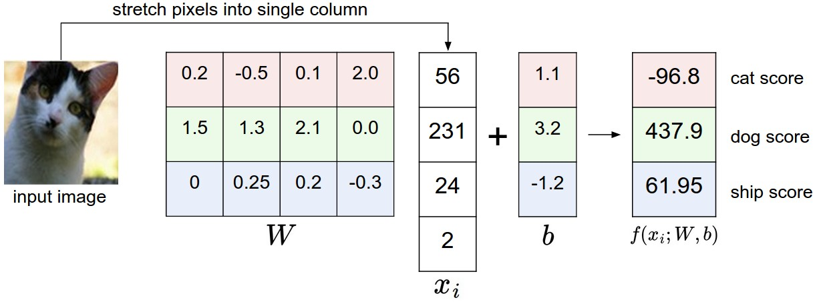
Linear classifiers – more than 2 class
Source: cs231n, http://cs231n.github.io/linear-classify/

Slide 13
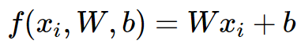
Linear classifiers – more than 2 class
Source: cs231n, http://cs231n.github.io/linear-classify/

Slide 14
Linear classifiers – more than 2 class
Image has all of its pixels flattened out to a single column vector of shape [D x 1].
Matrix W (of size [K x D]), and vector b (of size [K x 1]) are the parameters.
K is the number of classes.
Source: cs231n, http://cs231n.github.io/linear-classify/

Slide 15
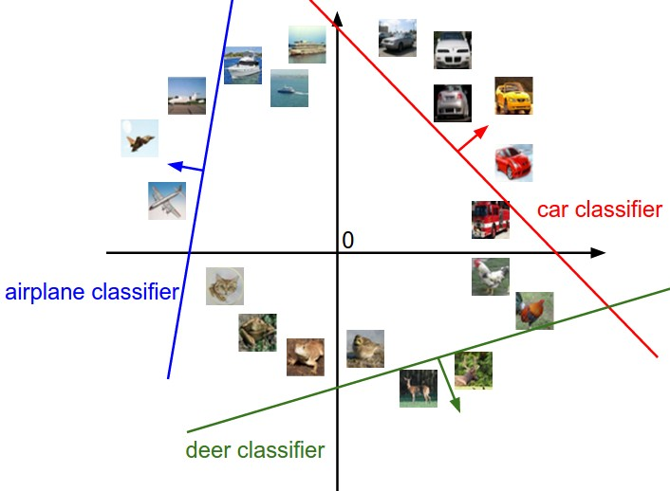
Analogy of images as high-dimensional points
Source: cs231n, http://cs231n.github.io/linear-classify/

Slide 16
Nearest neighbor vs. linear classifiers
Linear pros:
Low-dimensional parametric representation
Very fast at test time
Linear cons:
How to train the linear function?
What if data is not linearly separable?

Slide 17
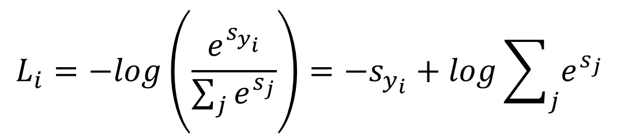
Softmax Classifier
Interprets the class scores as the unnormalized log probabilities for each class and replace the hinge loss with a cross-entropy loss that has the form:
$$L_{i}=−log\left(\frac{e^{s_{y_{i}}^{}}}{\sum_{j}{e^{s_{j}}}}\right)=−s_{y_{i}}+log\sum_{j}{e^{s_{j}}}$$
Source: cs231n, http://cs231n.github.io/linear-classify/

Slide 18
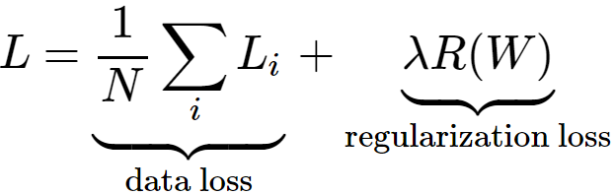
Softmax Classifier
Interprets the class scores as the unnormalized log probabilities for each class and replace the hinge loss with a cross-entropy loss that has the form:
Softmax Loss:
$$L_{i}=−log\left(\frac{e^{s_{y_{i}}^{}}}{\sum_{j}{e^{s_{j}}}}\right)=−s_{y_{i}}+log\sum_{j}{e^{s_{j}}}$$
Source: cs231n, http://cs231n.github.io/linear-classify/

Slide 19
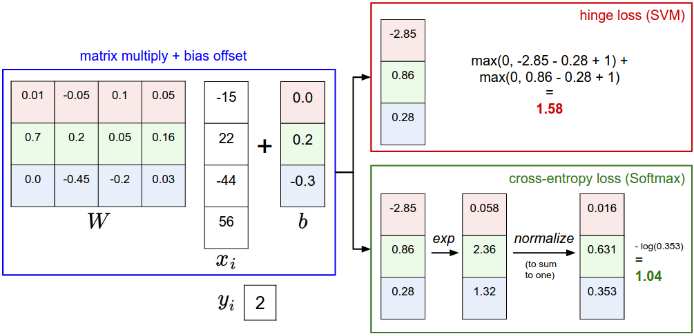
Hinge vs Cross-entropy Loss
Source: cs231n, http://cs231n.github.io/linear-classify/

Slide 20
From linear to nonlinear classifiers
To achieve good accuracy on challenging problems, we need to be able to train nonlinear models
Two strategies for making nonlinear predictors out of linear ones:
“Shallow” approach: nonlinear feature transformation followed by linear classifier
Feature transformation
Linear classifier
Input
Output

Slide 21
From linear to nonlinear classifiers
To achieve good accuracy on challenging problems, we need to be able to train nonlinear models
Two strategies for making nonlinear predictors out of linear ones:
“Shallow” approach: nonlinear feature transformation followed by linear classifier
“Deep” approach: stack multiple layers of linear predictors (interspersed with nonlinearities)
Feature transformation
Linear classifier
Input
Output
Layer 1
Layer 2
…
Layer N
Input
Output

Slide 22
Shallow approach
Feature transformation
Linear classifier
Input
Output
Image credit: Andrew Moore

Slide 23
Multi-layer neural networks
“Deep” approach: stack multiple layers of linear predictors (perceptrons) interspersed with nonlinearities
Layer 1
Layer 2
Layer 3
Input
Output

Slide 24
Perceptron
Input
$$x1$$
$$x2$$
$$x3$$
.
.
.
$$xD$$

Slide 25
Perceptron
Input
Weights
$$x1$$
$$w1$$
$$x2$$
$$w2$$
$$x3$$
.
.
.
$$w3$$
$$wD$$
$$xD$$

Slide 26
Perceptron
Input
Nonlinearity
Weights
$$x1$$
$$w1$$
$$x2$$
$$w2$$
$$x3$$
$$g$$
.
.
.
$$w3$$
$$wD$$
$$xD$$

Slide 27
Perceptron
Input
Nonlinearity
Weights
$$x1$$
$$w1$$
$$x2$$
$$w2$$
Output:
$${g(w}_{}^{T}x)$$
$$x3$$
$$g$$
.
.
.
$$w3$$
$$wD$$
$$xD$$

Slide 28
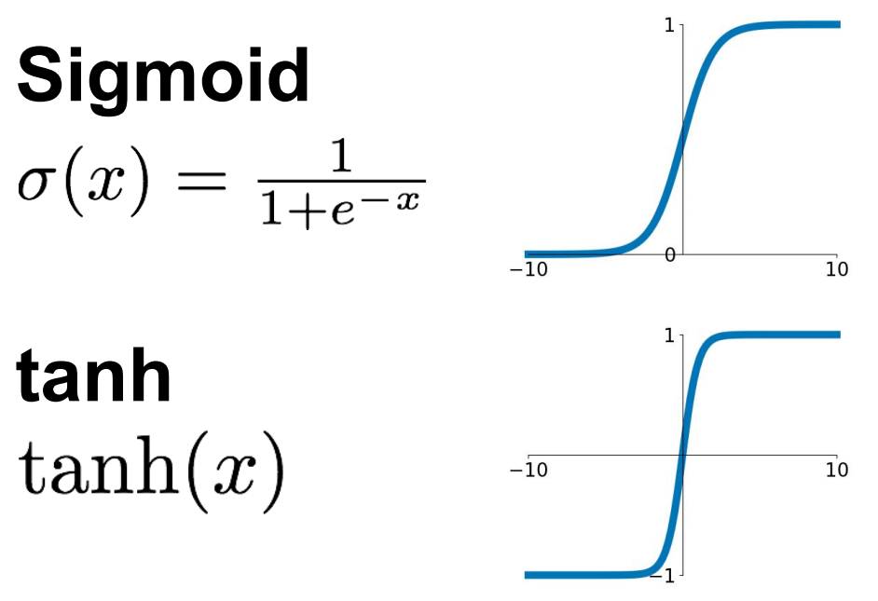
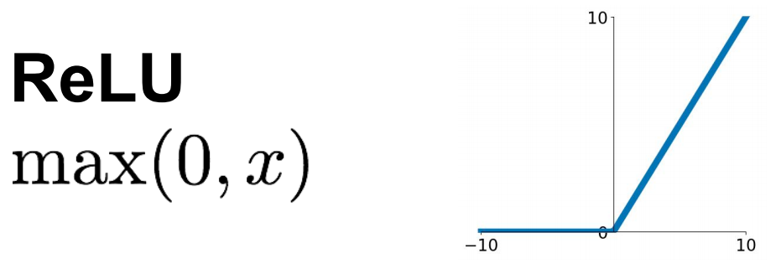
Common nonlinearities (or activation functions)
Source: Stanford 231n

Slide 29
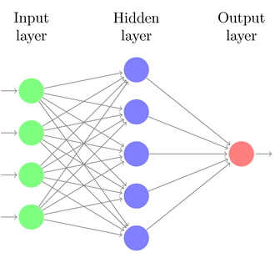
Two-layer neural network
Introduce a hidden layer of perceptrons computing linear combinations of inputs followed by nonlinearities
Individual dimensions of $x$

Slide 30
Two-layer neural network
Introduce a hidden layer of perceptrons computing linear combinations of inputs followed by nonlinearities
$${g(w}_{11}^{T}x)$$
$${g(w}_{12}^{T}x)$$
Individual dimensions of $x$
$${g(w}_{1K}^{T}x)$$

Slide 31
Two-layer neural network
Introduce a hidden layer of perceptrons computing linear combinations of inputs followed by nonlinearities
$${g(w}_{11}^{T}x)$$
$${g(w}_{12}^{T}x)$$
Individual dimensions of $x$
$$g(W_{1}x)$$
$${g(w}_{1K}^{T}x)$$
$W_{1}$ – matrix with rows $w_{1j}^{T}$

Slide 32
Two-layer neural network
Introduce a hidden layer of perceptrons computing linear combinations of inputs followed by nonlinearities
$${g(w}_{11}^{T}x)$$
$${g(w}_{12}^{T}x)$$
Individual dimensions of $x$
$$g(W_{1}x)$$
$$g\left(w_{2}^{T}g(W_{1}x)\right)$$
$${g(w}_{1K}^{T}x)$$
$W_{1}$ – matrix with rows $w_{1j}^{T}$

Slide 33

Two-layer neural network
Introduce a hidden layer of perceptrons computing linear combinations of inputs followed by nonlinearities
The bigger the hidden layer, the more expressive the model
Figure source

Slide 34
Two-layer neural network
Introduce a hidden layer of perceptrons computing linear combinations of inputs followed by nonlinearities
The bigger the hidden layer, the more expressive the model
A two-layer network is a universal function approximator
But the hidden layer may need to be huge
Figure source

Slide 35

Beyond two layers

Slide 36
“Deep” pipeline
Layer 1
Layer 2
Layer 3
Input
Output
Learn a feature hierarchy
Each layer extracts features from the output of previous layer
All layers are trained jointly

Slide 37
Hyperparameters in multi-layer networks
Number of layers, number of units per layer, activation function, loss function, regularization, regularization constant, optimizer, optimizer settings: learning rate schedule, number of epochs, batch size, etc.
Source: Stanford 231n

Slide 38
Hyperparameters in multi-layer networks
Number of hidden units in a two-layer network
Source: Stanford 231n

Slide 39
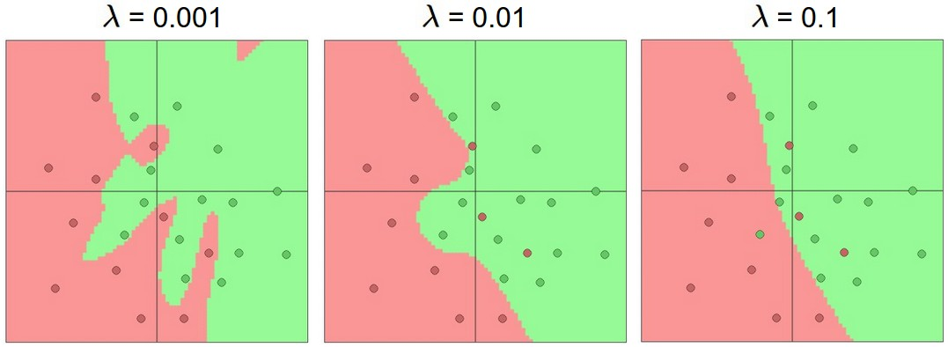
Hyperparameters in multi-layer networks
Regularization constant
Source: Stanford 231n

Slide 40
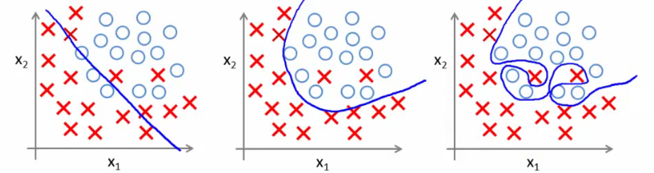
Model complexity and generalization
“Simple” model
“Intermediate” model
“Complex” model
Figure source

Slide 41
Model complexity and generalization
Generalization (test) error of learning algorithms has two main components:
Bias: error due to simplifying model assumptions
Variance: error due to randomness of training set
“Simple” model
“Intermediate” model
“Complex” model
Figure source

Slide 42
Model complexity and generalization
Generalization (test) error of learning algorithms has two main components:
Bias: error due to simplifying model assumptions
Variance: error due to randomness of training set
“Simple” model
“Intermediate” model
“Complex” model
High bias, low variance
Low bias, high variance
Figure source

Slide 43
Bias-variance tradeoff
Figure source

Slide 44
Bias-variance tradeoff
What if your model bias is too high?
Figure source

Slide 45
Bias-variance tradeoff
What if your model bias is too high?
Your model is underfitting – it is incapable of capturing the important characteristics of the training data
Underfitting
Figure source

Slide 46
Bias-variance tradeoff
What if your model bias is too high?
Your model is underfitting – it is incapable of capturing the important characteristics of the training data
What if your model variance is too high?
Underfitting
Figure source

Slide 47
Bias-variance tradeoff
What if your model bias is too high?
Your model is underfitting – it is incapable of capturing the important characteristics of the training data
What if your model variance is too high?
Your model is overfitting – it is fitting noise and unimportant characteristics of the data
Underfitting
Overfitting
Figure source

Slide 48
Bias-variance tradeoff
What if your model bias is too high?
Your model is underfitting – it is incapable of capturing the important characteristics of the training data
What if your model variance is too high?
Your model is overfitting – it is fitting noise and unimportant characteristics of the data
How to recognize underfitting or overfitting?
Underfitting
Overfitting
Figure source

Slide 49
Bias-variance tradeoff
What if your model bias is too high?
Your model is underfitting – it is incapable of capturing the important characteristics of the training data
What if your model variance is too high?
Your model is overfitting – it is fitting noise and unimportant characteristics of the data
How to recognize underfitting or overfitting?
Need to look at both training and test error
Underfitting: training and test error are both high
Overfitting: training error is low, test error is high
Figure source

Slide 50
Looking at training and test error
Test error
Error
Training error
High Bias
Low Variance
Complexity
Low Bias
High Variance
Source: D. Hoiem

Slide 51
Optimization
Optimization is the process of finding the set of parameters W that minimize the loss function.
Strategy #1:First very bad idea solution: Random search:
Simply try out many different random weights and keep track of
what works best.
Source: http://cs231n.github.io
Notes:
“Non-parametric” classifier: the entire training set is essentially the model parameters.
Pros:
Very fast at training time
Flexible: all it requires is a way to compute similarity or distances between pairs of features. Applies to many different kinds of features.
Works with any number of classes.
Works well in practice for large datasets (but see cons)
Cons:
Slow at test time (need to compute distances between test example and every training example)

Slide 52
Optimization
Optimization is the process of finding the set of parameters W that minimize the loss function.
Strategy #1:First very bad idea solution: Random search:
Simply try out many different random weights and keep track of
what works best.
Strategy #2: Random local search:
Start out with a random W, generate random changes δW to it and
if the loss at the changed W+δW is lower, we will perform an update.
Source: http://cs231n.github.io
Notes:
“Non-parametric” classifier: the entire training set is essentially the model parameters.
Pros:
Very fast at training time
Flexible: all it requires is a way to compute similarity or distances between pairs of features. Applies to many different kinds of features.
Works with any number of classes.
Works well in practice for large datasets (but see cons)
Cons:
Slow at test time (need to compute distances between test example and every training example)

Slide 53
Optimization
Optimization is the process of finding the set of parameters W that minimize the loss function.
Strategy #1:First very bad idea solution: Random search:
Simply try out many different random weights and keep track of
what works best.
Strategy #2: Random local search:
Start out with a random W, generate random changes δW to it and
if the loss at the changed W+δW is lower, we will perform an update.
Strategy #3: Following the gradients:
There is no need to randomly search for a good direction:
this direction is related to the gradient of the loss function.
Source: http://cs231n.github.io
Notes:
“Non-parametric” classifier: the entire training set is essentially the model parameters.
Pros:
Very fast at training time
Flexible: all it requires is a way to compute similarity or distances between pairs of features. Applies to many different kinds of features.
Works with any number of classes.
Works well in practice for large datasets (but see cons)
Cons:
Slow at test time (need to compute distances between test example and every training example)

Slide 54
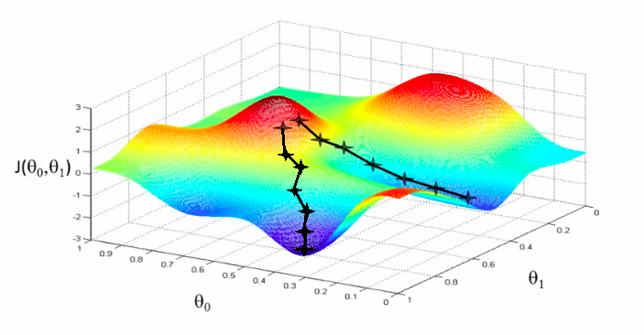
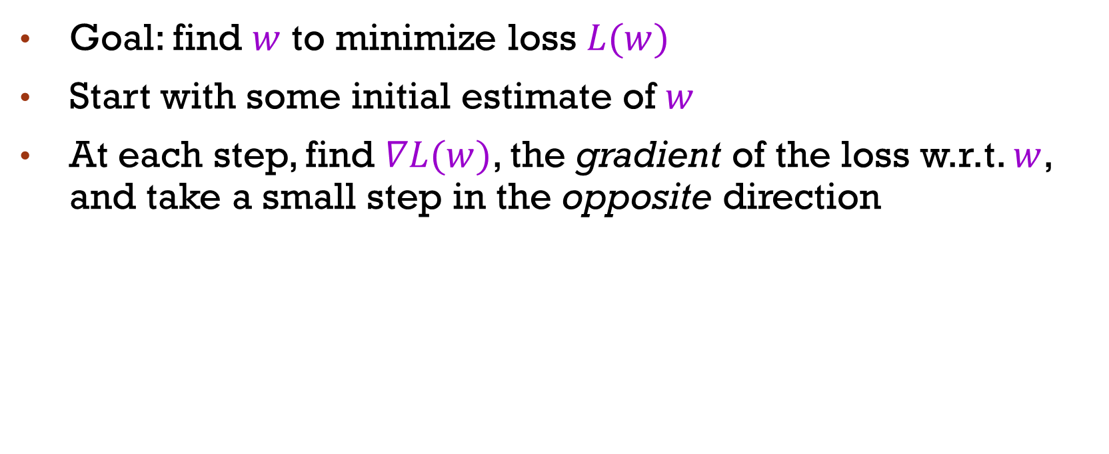
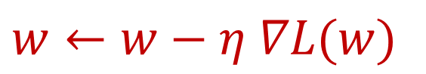
Gradient descent
Goal: find $w$ to minimize loss $L(w)$
Start with some initial estimate of $w$
At each step, find $∇L(w)$, the gradient of the loss w.r.t. $w$, and take a small step in the opposite direction
$$w←w−η ∇L(w)$$
w₂
w₁

Slide 55
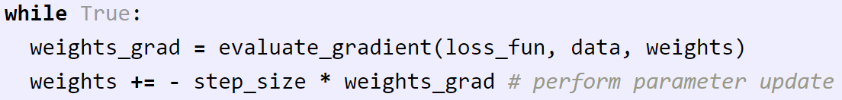
Gradient Descent
The procedure of repeatedly evaluating the gradient of loss function and then performing a parameter update.
Vanilla (Original) Gradient Descent:
Source: http://cs231n.github.io
Notes:
“Non-parametric” classifier: the entire training set is essentially the model parameters.
Pros:
Very fast at training time
Flexible: all it requires is a way to compute similarity or distances between pairs of features. Applies to many different kinds of features.
Works with any number of classes.
Works well in practice for large datasets (but see cons)
Cons:
Slow at test time (need to compute distances between test example and every training example)

Slide 56
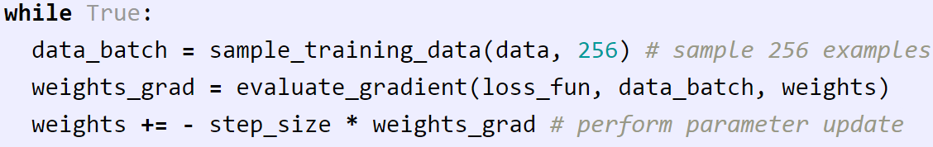
Gradient Descent
The procedure of repeatedly evaluating the gradient of loss function and then performing a parameter update.
Vanilla (Original) Gradient Descent:
Mini-batch Gradient Descent (MGD):
Source: http://cs231n.github.io
Notes:
“Non-parametric” classifier: the entire training set is essentially the model parameters.
Pros:
Very fast at training time
Flexible: all it requires is a way to compute similarity or distances between pairs of features. Applies to many different kinds of features.
Works with any number of classes.
Works well in practice for large datasets (but see cons)
Cons:
Slow at test time (need to compute distances between test example and every training example)

Slide 57
Gradient Descent
The procedure of repeatedly evaluating the gradient of loss function and then performing a parameter update.
Vanilla (Original) Gradient Descent:
Mini-batch Gradient Descent (MGD):
Stochastic Gradient Descent (SGD):
Special case of MGD when mini-batch contains only a single example
Source: http://cs231n.github.io
Notes:
“Non-parametric” classifier: the entire training set is essentially the model parameters.
Pros:
Very fast at training time
Flexible: all it requires is a way to compute similarity or distances between pairs of features. Applies to many different kinds of features.
Works with any number of classes.
Works well in practice for large datasets (but see cons)
Cons:
Slow at test time (need to compute distances between test example and every training example)

Slide 58
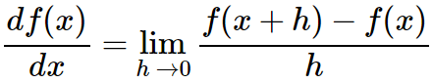
Interpretation of the gradient
Interpretation. Derivatives indicate the rate of change of a function with respect to that variable surrounding an infinitesimally small region near a particular point:
Source: http://cs231n.github.io
Notes:
“Non-parametric” classifier: the entire training set is essentially the model parameters.
Pros:
Very fast at training time
Flexible: all it requires is a way to compute similarity or distances between pairs of features. Applies to many different kinds of features.
Works with any number of classes.
Works well in practice for large datasets (but see cons)
Cons:
Slow at test time (need to compute distances between test example and every training example)

Slide 59
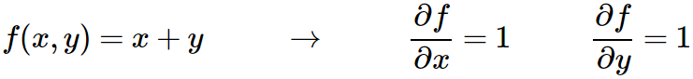
Interpretation of the gradient
Interpretation. Derivatives indicate the rate of change of a function with respect to that variable surrounding an infinitesimally small region near a particular point:
Source: http://cs231n.github.io
Notes:
“Non-parametric” classifier: the entire training set is essentially the model parameters.
Pros:
Very fast at training time
Flexible: all it requires is a way to compute similarity or distances between pairs of features. Applies to many different kinds of features.
Works with any number of classes.
Works well in practice for large datasets (but see cons)
Cons:
Slow at test time (need to compute distances between test example and every training example)

Slide 60
Interpretation of the gradient
Interpretation. Derivatives indicate the rate of change of a function with respect to that variable surrounding an infinitesimally small region near a particular point:
Source: http://cs231n.github.io
Notes:
“Non-parametric” classifier: the entire training set is essentially the model parameters.
Pros:
Very fast at training time
Flexible: all it requires is a way to compute similarity or distances between pairs of features. Applies to many different kinds of features.
Works with any number of classes.
Works well in practice for large datasets (but see cons)
Cons:
Slow at test time (need to compute distances between test example and every training example)

Slide 61
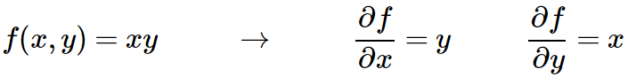
Interpretation of the gradient
Interpretation. Derivatives indicate the rate of change of a function with respect to that variable surrounding an infinitesimally small region near a particular point:
Source: http://cs231n.github.io
Notes:
“Non-parametric” classifier: the entire training set is essentially the model parameters.
Pros:
Very fast at training time
Flexible: all it requires is a way to compute similarity or distances between pairs of features. Applies to many different kinds of features.
Works with any number of classes.
Works well in practice for large datasets (but see cons)
Cons:
Slow at test time (need to compute distances between test example and every training example)

Slide 62
Interpretation of the gradient
Interpretation. Derivatives indicate the rate of change of a function with respect to that variable surrounding an infinitesimally small region near a particular point:
Source: http://cs231n.github.io
Notes:
“Non-parametric” classifier: the entire training set is essentially the model parameters.
Pros:
Very fast at training time
Flexible: all it requires is a way to compute similarity or distances between pairs of features. Applies to many different kinds of features.
Works with any number of classes.
Works well in practice for large datasets (but see cons)
Cons:
Slow at test time (need to compute distances between test example and every training example)

Slide 63
Interpretation of the gradient
Interpretation. Derivatives indicate the rate of change of a function with respect to that variable surrounding an infinitesimally small region near a particular point:
Source: http://cs231n.github.io
Notes:
“Non-parametric” classifier: the entire training set is essentially the model parameters.
Pros:
Very fast at training time
Flexible: all it requires is a way to compute similarity or distances between pairs of features. Applies to many different kinds of features.
Works with any number of classes.
Works well in practice for large datasets (but see cons)
Cons:
Slow at test time (need to compute distances between test example and every training example)

Slide 64
Interpretation of the gradient
Interpretation. Derivatives indicate the rate of change of a function with respect to that variable surrounding an infinitesimally small region near a particular point:
Source: http://cs231n.github.io
Notes:
“Non-parametric” classifier: the entire training set is essentially the model parameters.
Pros:
Very fast at training time
Flexible: all it requires is a way to compute similarity or distances between pairs of features. Applies to many different kinds of features.
Works with any number of classes.
Works well in practice for large datasets (but see cons)
Cons:
Slow at test time (need to compute distances between test example and every training example)

Slide 65
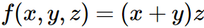
Compound expressions with chain rule
Source: http://cs231n.github.io
Notes:
“Non-parametric” classifier: the entire training set is essentially the model parameters.
Pros:
Very fast at training time
Flexible: all it requires is a way to compute similarity or distances between pairs of features. Applies to many different kinds of features.
Works with any number of classes.
Works well in practice for large datasets (but see cons)
Cons:
Slow at test time (need to compute distances between test example and every training example)

Slide 66
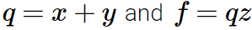
Compound expressions with chain rule
Source: http://cs231n.github.io
Notes:
“Non-parametric” classifier: the entire training set is essentially the model parameters.
Pros:
Very fast at training time
Flexible: all it requires is a way to compute similarity or distances between pairs of features. Applies to many different kinds of features.
Works with any number of classes.
Works well in practice for large datasets (but see cons)
Cons:
Slow at test time (need to compute distances between test example and every training example)

Slide 67
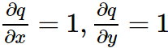
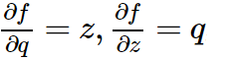
Compound expressions with chain rule
Source: http://cs231n.github.io
Notes:
“Non-parametric” classifier: the entire training set is essentially the model parameters.
Pros:
Very fast at training time
Flexible: all it requires is a way to compute similarity or distances between pairs of features. Applies to many different kinds of features.
Works with any number of classes.
Works well in practice for large datasets (but see cons)
Cons:
Slow at test time (need to compute distances between test example and every training example)

Slide 68
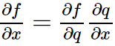
Compound expressions with chain rule
Chain rule:
Source: http://cs231n.github.io
Notes:
“Non-parametric” classifier: the entire training set is essentially the model parameters.
Pros:
Very fast at training time
Flexible: all it requires is a way to compute similarity or distances between pairs of features. Applies to many different kinds of features.
Works with any number of classes.
Works well in practice for large datasets (but see cons)
Cons:
Slow at test time (need to compute distances between test example and every training example)

Slide 69
Compound expressions with chain rule
Source: http://cs231n.github.io
Notes:
“Non-parametric” classifier: the entire training set is essentially the model parameters.
Pros:
Very fast at training time
Flexible: all it requires is a way to compute similarity or distances between pairs of features. Applies to many different kinds of features.
Works with any number of classes.
Works well in practice for large datasets (but see cons)
Cons:
Slow at test time (need to compute distances between test example and every training example)

Slide 70
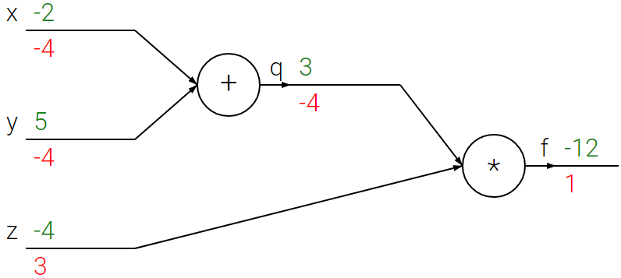
Compound expressions with chain rule
Source: http://cs231n.github.io
Notes:
“Non-parametric” classifier: the entire training set is essentially the model parameters.
Pros:
Very fast at training time
Flexible: all it requires is a way to compute similarity or distances between pairs of features. Applies to many different kinds of features.
Works with any number of classes.
Works well in practice for large datasets (but see cons)
Cons:
Slow at test time (need to compute distances between test example and every training example)

Slide 71
Compound expressions with chain rule
Source: http://cs231n.github.io
Notes:
“Non-parametric” classifier: the entire training set is essentially the model parameters.
Pros:
Very fast at training time
Flexible: all it requires is a way to compute similarity or distances between pairs of features. Applies to many different kinds of features.
Works with any number of classes.
Works well in practice for large datasets (but see cons)
Cons:
Slow at test time (need to compute distances between test example and every training example)

Slide 72
Compound expressions with chain rule
Source: http://cs231n.github.io
Notes:
“Non-parametric” classifier: the entire training set is essentially the model parameters.
Pros:
Very fast at training time
Flexible: all it requires is a way to compute similarity or distances between pairs of features. Applies to many different kinds of features.
Works with any number of classes.
Works well in practice for large datasets (but see cons)
Cons:
Slow at test time (need to compute distances between test example and every training example)

Slide 73
Compound expressions with chain rule
Source: http://cs231n.github.io
Notes:
“Non-parametric” classifier: the entire training set is essentially the model parameters.
Pros:
Very fast at training time
Flexible: all it requires is a way to compute similarity or distances between pairs of features. Applies to many different kinds of features.
Works with any number of classes.
Works well in practice for large datasets (but see cons)
Cons:
Slow at test time (need to compute distances between test example and every training example)

Slide 74
Compound expressions with chain rule
Source: http://cs231n.github.io
Notes:
“Non-parametric” classifier: the entire training set is essentially the model parameters.
Pros:
Very fast at training time
Flexible: all it requires is a way to compute similarity or distances between pairs of features. Applies to many different kinds of features.
Works with any number of classes.
Works well in practice for large datasets (but see cons)
Cons:
Slow at test time (need to compute distances between test example and every training example)

Slide 75
Compound expressions with chain rule
Source: http://cs231n.github.io
Notes:
“Non-parametric” classifier: the entire training set is essentially the model parameters.
Pros:
Very fast at training time
Flexible: all it requires is a way to compute similarity or distances between pairs of features. Applies to many different kinds of features.
Works with any number of classes.
Works well in practice for large datasets (but see cons)
Cons:
Slow at test time (need to compute distances between test example and every training example)

Slide 76
Compound expressions with chain rule
Source: http://cs231n.github.io
Notes:
“Non-parametric” classifier: the entire training set is essentially the model parameters.
Pros:
Very fast at training time
Flexible: all it requires is a way to compute similarity or distances between pairs of features. Applies to many different kinds of features.
Works with any number of classes.
Works well in practice for large datasets (but see cons)
Cons:
Slow at test time (need to compute distances between test example and every training example)

Slide 77
Compound expressions with chain rule
Source: http://cs231n.github.io
Notes:
“Non-parametric” classifier: the entire training set is essentially the model parameters.
Pros:
Very fast at training time
Flexible: all it requires is a way to compute similarity or distances between pairs of features. Applies to many different kinds of features.
Works with any number of classes.
Works well in practice for large datasets (but see cons)
Cons:
Slow at test time (need to compute distances between test example and every training example)

Slide 78
Compound expressions with chain rule
Source: http://cs231n.github.io
Notes:
“Non-parametric” classifier: the entire training set is essentially the model parameters.
Pros:
Very fast at training time
Flexible: all it requires is a way to compute similarity or distances between pairs of features. Applies to many different kinds of features.
Works with any number of classes.
Works well in practice for large datasets (but see cons)
Cons:
Slow at test time (need to compute distances between test example and every training example)

Slide 79
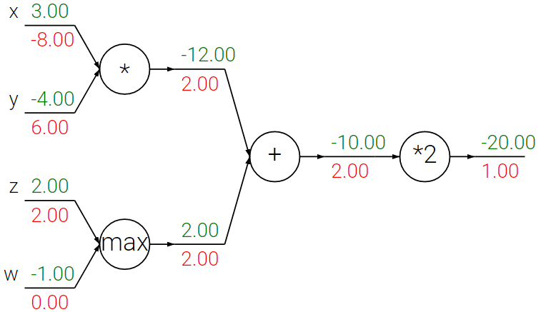
Forward and Backward Pass
Source: http://cs231n.github.io
Notes:
“Non-parametric” classifier: the entire training set is essentially the model parameters.
Pros:
Very fast at training time
Flexible: all it requires is a way to compute similarity or distances between pairs of features. Applies to many different kinds of features.
Works with any number of classes.
Works well in practice for large datasets (but see cons)
Cons:
Slow at test time (need to compute distances between test example and every training example)

Slide 80
Forward and Backward Pass
Source: http://cs231n.github.io
Notes:
“Non-parametric” classifier: the entire training set is essentially the model parameters.
Pros:
Very fast at training time
Flexible: all it requires is a way to compute similarity or distances between pairs of features. Applies to many different kinds of features.
Works with any number of classes.
Works well in practice for large datasets (but see cons)
Cons:
Slow at test time (need to compute distances between test example and every training example)

Slide 81
Forward and Backward Pass
Source: http://cs231n.github.io
Notes:
“Non-parametric” classifier: the entire training set is essentially the model parameters.
Pros:
Very fast at training time
Flexible: all it requires is a way to compute similarity or distances between pairs of features. Applies to many different kinds of features.
Works with any number of classes.
Works well in practice for large datasets (but see cons)
Cons:
Slow at test time (need to compute distances between test example and every training example)

Slide 82
Forward and Backward Pass
Source: http://cs231n.github.io
Notes:
“Non-parametric” classifier: the entire training set is essentially the model parameters.
Pros:
Very fast at training time
Flexible: all it requires is a way to compute similarity or distances between pairs of features. Applies to many different kinds of features.
Works with any number of classes.
Works well in practice for large datasets (but see cons)
Cons:
Slow at test time (need to compute distances between test example and every training example)

Slide 83
Forward and Backward Pass
Source: http://cs231n.github.io
Notes:
“Non-parametric” classifier: the entire training set is essentially the model parameters.
Pros:
Very fast at training time
Flexible: all it requires is a way to compute similarity or distances between pairs of features. Applies to many different kinds of features.
Works with any number of classes.
Works well in practice for large datasets (but see cons)
Cons:
Slow at test time (need to compute distances between test example and every training example)

Slide 84
Forward and Backward Pass
Source: http://cs231n.github.io
Notes:
“Non-parametric” classifier: the entire training set is essentially the model parameters.
Pros:
Very fast at training time
Flexible: all it requires is a way to compute similarity or distances between pairs of features. Applies to many different kinds of features.
Works with any number of classes.
Works well in practice for large datasets (but see cons)
Cons:
Slow at test time (need to compute distances between test example and every training example)

Slide 85
Forward and Backward Pass
Source: http://cs231n.github.io
Notes:
“Non-parametric” classifier: the entire training set is essentially the model parameters.
Pros:
Very fast at training time
Flexible: all it requires is a way to compute similarity or distances between pairs of features. Applies to many different kinds of features.
Works with any number of classes.
Works well in practice for large datasets (but see cons)
Cons:
Slow at test time (need to compute distances between test example and every training example)

Slide 86
Forward and Backward Pass
Source: http://cs231n.github.io
Notes:
“Non-parametric” classifier: the entire training set is essentially the model parameters.
Pros:
Very fast at training time
Flexible: all it requires is a way to compute similarity or distances between pairs of features. Applies to many different kinds of features.
Works with any number of classes.
Works well in practice for large datasets (but see cons)
Cons:
Slow at test time (need to compute distances between test example and every training example)

Slide 87
Forward and Backward Pass
Source: http://cs231n.github.io
Notes:
“Non-parametric” classifier: the entire training set is essentially the model parameters.
Pros:
Very fast at training time
Flexible: all it requires is a way to compute similarity or distances between pairs of features. Applies to many different kinds of features.
Works with any number of classes.
Works well in practice for large datasets (but see cons)
Cons:
Slow at test time (need to compute distances between test example and every training example)

Slide 88
Forward and Backward Pass
Source: http://cs231n.github.io
Notes:
“Non-parametric” classifier: the entire training set is essentially the model parameters.
Pros:
Very fast at training time
Flexible: all it requires is a way to compute similarity or distances between pairs of features. Applies to many different kinds of features.
Works with any number of classes.
Works well in practice for large datasets (but see cons)
Cons:
Slow at test time (need to compute distances between test example and every training example)

Slide 89
Forward and Backward Pass
Source: http://cs231n.github.io
Notes:
“Non-parametric” classifier: the entire training set is essentially the model parameters.
Pros:
Very fast at training time
Flexible: all it requires is a way to compute similarity or distances between pairs of features. Applies to many different kinds of features.
Works with any number of classes.
Works well in practice for large datasets (but see cons)
Cons:
Slow at test time (need to compute distances between test example and every training example)

Slide 90
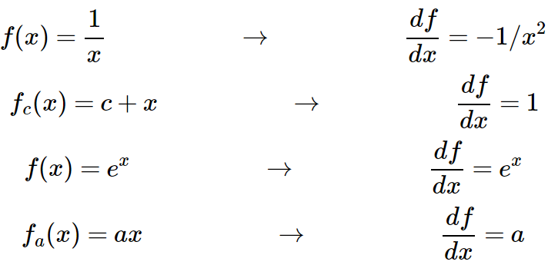
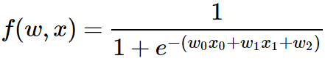
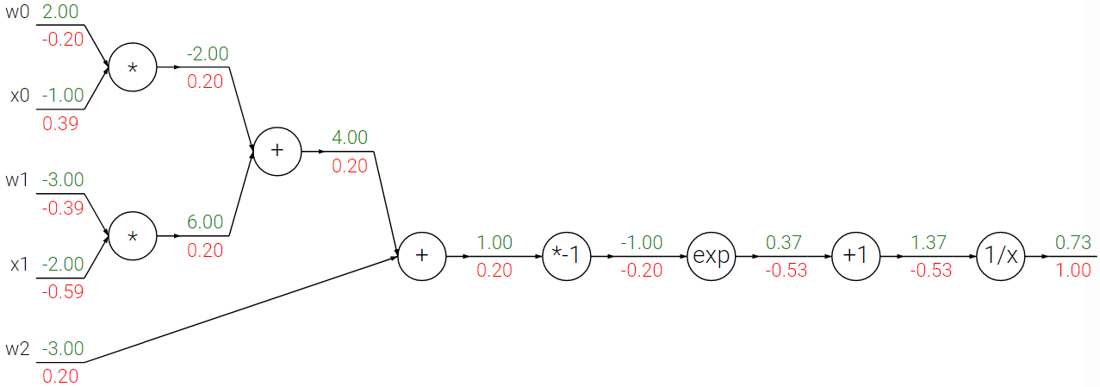
Sigmoid example
-0.20
0.20
0.40
0.20
-0.40
0.20
0.20
-0.20
-0.53
-0.53
1.00
-0.60
0.20
Modified from: http://cs231n.github.io
Notes:
“Non-parametric” classifier: the entire training set is essentially the model parameters.
Pros:
Very fast at training time
Flexible: all it requires is a way to compute similarity or distances between pairs of features. Applies to many different kinds of features.
Works with any number of classes.
Works well in practice for large datasets (but see cons)
Cons:
Slow at test time (need to compute distances between test example and every training example)

Slide 91
Perceptron
Supervised learning of binary classifier
Input
Bias
b
Weights
x₁
w₁
x₂
w₂
Output: sign(w⋅x + b)
x₃
w₃
.
.
.
w_{D}
x_{D}

Slide 92
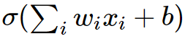
Single neuron as a linear classifier
Binary Softmax classifier (Logistic Regression)
Source: http://cs231n.github.io

Slide 93
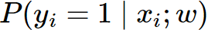
Single neuron as a linear classifier
Binary Softmax classifier (Logistic Regression)
Probability of one of the classes:
Source: http://cs231n.github.io

Slide 94
Single neuron as a linear classifier
Binary Softmax classifier (Logistic Regression)
Probability of one of the classes:
Probability of the other class would be:
Source: http://cs231n.github.io

Slide 95
Single neuron as a linear classifier
Binary Softmax classifier (Logistic Regression)
Probability of one of the classes:
Probability of the other class would be:
Binary SVM classifier:
Alternatively, we could attach a max-margin hinge loss to the output of the neuron and train it to become a binary Support Vector Machine.
Source: http://cs231n.github.io

Slide 96


Loose inspiration: Human neurons
Source: http://cs231n.github.io
Notes:
From Wikipedia: At the majority of synapses, signals are sent from the axon of one neuron to a dendrite of another... All neurons are electrically excitable, maintaining voltage gradients across their membranes… If the voltage changes by a large enough amount, an all-or-none electrochemical pulse called an action potential is generated, which travels rapidly along the cell's axon, and activates synaptic connections with other cells when it arrives.

Slide 97
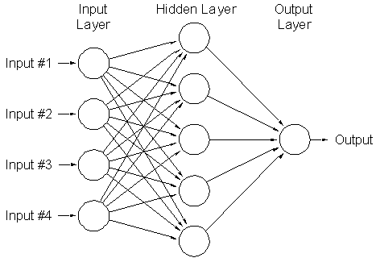
Multi-Layer Neural Networks
Network with a hidden layer:
Can represent nonlinear functions (provided each perceptron has a nonlinearity)

Slide 98
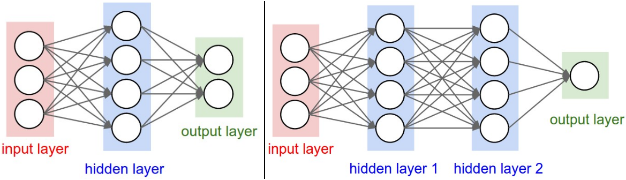
Sizing neural networks
First network (left):
No. of neurons (not counting the inputs):
No. of learnable parameters:
Source: http://cs231n.github.io

Slide 99
Sizing neural networks
First network (left):
No. of neurons (not counting the inputs): 4 + 2 = 6
No. of learnable parameters:
Source: http://cs231n.github.io

Slide 100
Sizing neural networks
First network (left):
No. of neurons (not counting the inputs): 4 + 2 = 6
No. of learnable parameters: [3 x 4] + [4 x 2] = 20 weights +
4 + 2 = 6 biases = 26.
Source: http://cs231n.github.io

Slide 101
Sizing neural networks
First network (left):
No. of neurons (not counting the inputs): 4 + 2 = 6
No. of learnable parameters: [3 x 4] + [4 x 2] = 20 weights +
4 + 2 = 6 biases = 26.
Second network (right):
No. of neurons (not counting the inputs):
No. of learnable parameters:
Source: http://cs231n.github.io

Slide 102
Sizing neural networks
First network (left):
No. of neurons (not counting the inputs): 4 + 2 = 6
No. of learnable parameters: [3 x 4] + [4 x 2] = 20 weights +
4 + 2 = 6 biases = 26.
Second network (right):
No. of neurons (not counting the inputs): 4 + 4 + 1 = 9
No. of learnable parameters: [3x4]+[4x4]+[4x1] = 32 weights +
4 + 4 + 1 = 9 biases = 41.
Source: http://cs231n.github.io

Slide 103
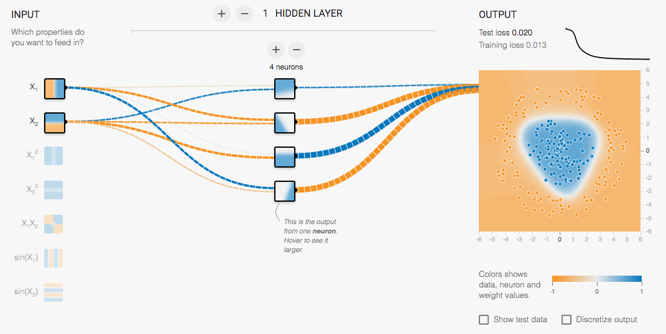
Multi-Layer network demo
http://playground.tensorflow.org/

Slide 104
Recall: Multi-layer neural networks
The function computed by the network is a composition of the functions computed by individual layers (e.g., linear layers and nonlinearities):
Layer 1
Layer 2
…
Layer K
Input
Output

Slide 105
Recall: Multi-layer neural networks
The function computed by the network is a composition of the functions computed by individual layers (e.g., linear layers and nonlinearities):
More precisely:
Layer 1
Layer 2
…
Layer K
Input
Output

Slide 106
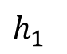
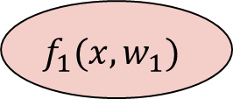
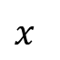
Recall: Multi-layer neural networks
The function computed by the network is a composition of the functions computed by individual layers (e.g., linear layers and nonlinearities):
More precisely:
Layer 1
Layer 2
…
Layer K
Input
Output
hidden representation
$$f_{1}(x,w_{1})$$
$$h_{1}$$
$$x$$
input
first layer transformation

Slide 107
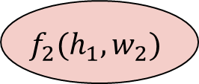
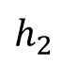
Recall: Multi-layer neural networks
The function computed by the network is a composition of the functions computed by individual layers (e.g., linear layers and nonlinearities):
More precisely:
Layer 1
Layer 2
…
Layer K
Input
Output
hidden representation
$$h_{1}$$
$$h_{2}$$
$$f_{1}(x,w_{1})$$
$$f_{2}(h_{1},w_{2})$$
$$x$$
input
first layer transformation
second layer transformation

Slide 108
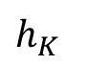
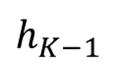
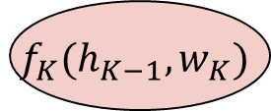
Recall: Multi-layer neural networks
The function computed by the network is a composition of the functions computed by individual layers (e.g., linear layers and nonlinearities):
More precisely:
Layer 1
Layer 2
…
Layer K
Input
Output
hidden representation
$$h_{1}$$
$$h_{2}$$
$$h_{K−1}$$
$$f_{1}(x,w_{1})$$
$$f_{2}(h_{1},w_{2})$$
$$f_{K}(h_{K−1},w_{K})$$
$$x$$
…
$$h_{K}$$
input
first layer transformation
second layer transformation
output layer
output

Slide 109
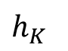
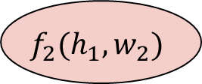
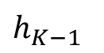
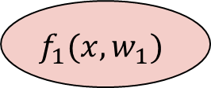




Training a multi-layer network
hidden representation
output
$$h_{1}$$
$$h_{2}$$
$$h_{K−1}$$
$$h_{K}$$
$$f_{1}(x,w_{1})$$
$$f_{2}(h_{1},w_{2})$$
$$f_{K}(h_{K−1},w_{K})$$
$$x$$
…
input
first layer transformation
second layer transformation
output layer

Slide 110


Training a multi-layer network
hidden representation
output
$$h_{1}$$
$$h_{2}$$
$$h_{K−1}$$
$$h_{K}$$
$$f_{1}(x,w_{1})$$
$$f_{2}(h_{1},w_{2})$$
$$f_{K}(h_{K−1},w_{K})$$
$$l(h_{k},y)$$
$$x$$
…
$$e$$
input
first layer transformation
second layer transformation
output layer
loss function
error

Slide 111

Training a multi-layer network
hidden representation
output
$$h_{1}$$
$$h_{2}$$
$$h_{K−1}$$
$$h_{K}$$
$$f_{1}(x,w_{1})$$
$$f_{2}(h_{1},w_{2})$$
$$f_{K}(h_{K−1},w_{K})$$
$$l(h_{k},y)$$
$$x$$
…
$$e$$
input
first layer transformation
second layer transformation
output layer
loss function
error
What is the SGD update for the parameters $w_{k}$of the kth layer?

Slide 112

Training a multi-layer network
hidden representation
output
$$h_{1}$$
$$h_{2}$$
$$h_{K−1}$$
$$h_{K}$$
$$f_{1}(x,w_{1})$$
$$f_{2}(h_{1},w_{2})$$
$$f_{K}(h_{K−1},w_{K})$$
$$l(h_{k},y)$$
$$x$$
…
$$e$$
input
first layer transformation
second layer transformation
output layer
loss function
error
What is the SGD update for the parameters $w_{k}$of the kth layer?
$w_{k}←w_{k}−η\frac{∂e}{∂w_{k}}$

Slide 113

Training a multi-layer network
hidden representation
output
$$h_{1}$$
$$h_{2}$$
$$h_{K−1}$$
$$h_{K}$$
$$f_{1}(x,w_{1})$$
$$f_{2}(h_{1},w_{2})$$
$$f_{K}(h_{K−1},w_{K})$$
$$l(h_{k},y)$$
$$x$$
…
$$e$$
input
first layer transformation
second layer transformation
output layer
loss function
error
What is the SGD update for the parameters $w_{k}$of the kth layer?
$w_{k}←w_{k}−η\frac{∂e}{∂w_{k}}$
To train the network, we need to find the gradient of the error w.r.t. the parameters of each layer, $\frac{∂e}{∂w_{k}}$

Slide 114



Computation graph
$$w_{1}$$
$$w_{2}$$
$$w_{K}$$
$$h_{1}$$
$$h_{2}$$
$$h_{K−1}$$
$$h_{K}$$
$$f_{1}(x,w_{1})$$
$$f_{2}(h_{1},w_{2})$$
$$f_{K}(h_{K−1},w_{K})$$
$$l(h_{k},y)$$
$$x$$
…
$$e$$

Slide 115






Chain rule
$$w_{1}$$
$$h_{1}$$
Let’s start with $k=1$
$$f_{1}(x,w_{1})$$
$$l(h_{1},y)$$
$$x$$
$$e$$
$$e=l\left(f_{1}\left(x,w_{1}\right),y\right)$$

Slide 116


Chain rule
$$w_{1}$$
$$h_{1}$$
Let’s start with $k=1$
$$f_{1}(x,w_{1})$$
$$l(h_{1},y)$$
$$x$$
$$e$$
$$\frac{∂e}{∂h_{1}}$$
$$\frac{∂h_{1}}{∂w_{1}}$$
$$e=l\left(f_{1}\left(x,w_{1}\right),y\right)$$

Slide 117

Chain rule
$$w_{1}$$
$$w_{1}$$
$$h_{1}$$
Let’s start with $k=1$
$$f_{1}(x,w_{1})$$
$$l(h_{1},y)$$
$$x$$
$$e$$
$$\frac{∂e}{∂h_{1}}$$
$$\frac{∂h_{1}}{∂w_{1}}$$
$$e=l\left(f_{1}\left(x,w_{1}\right),y\right)$$
$\frac{∂}{∂w_{1}}l\left(f_{1}\left(x,w_{1}\right),y\right)=\frac{∂e}{∂h_{1}}\frac{∂h_{1}}{∂w_{1}}$

Slide 118

Chain rule
$$w_{1}$$
$$h_{1}$$
Let’s start with $k=1$
$$f_{1}(x,w_{1})$$
$$l(h_{1},y)$$
$$x$$
$$e$$
$$\frac{∂e}{∂h_{1}}$$
$$\frac{∂h_{1}}{∂w_{1}}$$
$$e=l\left(f_{1}\left(x,w_{1}\right),y\right)$$
$\frac{∂}{∂w_{1}}l\left(f_{1}\left(x,w_{1}\right),y\right)=\frac{∂e}{∂h_{1}}\frac{∂h_{1}}{∂w_{1}}$
Example: $e{=(y−w_{1}^{T}x)}^{2}$

Slide 119

Chain rule
$$w_{1}$$
$$h_{1}$$
Let’s start with $k=1$
$$f_{1}(x,w_{1})$$
$$l(h_{1},y)$$
$$x$$
$$e$$
$$\frac{∂e}{∂h_{1}}$$
$$\frac{∂h_{1}}{∂w_{1}}$$
$$e=l\left(f_{1}\left(x,w_{1}\right),y\right)$$
$\frac{∂}{∂w_{1}}l\left(f_{1}\left(x,w_{1}\right),y\right)=\frac{∂e}{∂h_{1}}\frac{∂h_{1}}{∂w_{1}}$
Example: $e{=(y−w_{1}^{T}x)}^{2}$
$$h_{1}=f_{1}\left(x,w_{1}\right)=w_{1}^{T}x$$
$$e=l\left(h_{1},y\right)={(y−h_{1})}^{2}$$

Slide 120


Chain rule
$$w_{1}$$
$$h_{1}$$
Let’s start with $k=1$
$$f_{1}(x,w_{1})$$
$$l(h_{1},y)$$
$$x$$
$$e$$
$$\frac{∂e}{∂h_{1}}$$
$$\frac{∂h_{1}}{∂w_{1}}$$
$$e=l\left(f_{1}\left(x,w_{1}\right),y\right)$$
$\frac{∂}{∂w_{1}}l\left(f_{1}\left(x,w_{1}\right),y\right)=\frac{∂e}{∂h_{1}}\frac{∂h_{1}}{∂w_{1}}$
Example: $e{=(y−w_{1}^{T}x)}^{2}$
$$h_{1}=f_{1}\left(x,w_{1}\right)=w_{1}^{T}x$$
$$e=l\left(h_{1},y\right)={(y−h_{1})}^{2}$$
$$\frac{∂h_{1}}{∂w_{1}}= ??????$$
$$\frac{∂e}{∂h_{1}}= ??????$$

Slide 121


Chain rule
$$w_{1}$$
$$h_{1}$$
Let’s start with $k=1$
$$f_{1}(x,w_{1})$$
$$l(h_{1},y)$$
$$x$$
$$e$$
$$\frac{∂e}{∂h_{1}}$$
$$\frac{∂h_{1}}{∂w_{1}}$$
$$e=l\left(f_{1}\left(x,w_{1}\right),y\right)$$
$\frac{∂}{∂w_{1}}l\left(f_{1}\left(x,w_{1}\right),y\right)=\frac{∂e}{∂h_{1}}\frac{∂h_{1}}{∂w_{1}}$
Example: $e{=(y−w_{1}^{T}x)}^{2}$
$$h_{1}=f_{1}\left(x,w_{1}\right)=w_{1}^{T}x$$
$$e=l\left(h_{1},y\right)={(y−h_{1})}^{2}$$
$$\frac{∂h_{1}}{∂w_{1}}=x$$
$$\frac{∂e}{∂h_{1}}=−2\left(y−h_{1}\right)=−2\left(y−w_{1}^{T}x\right)$$

Slide 122

Chain rule
$$w_{1}$$
$$h_{1}$$
Let’s start with $k=1$
$$f_{1}(x,w_{1})$$
$$l(h_{1},y)$$
$$x$$
$$e$$
$$\frac{∂e}{∂h_{1}}$$
$$\frac{∂h_{1}}{∂w_{1}}$$
$$e=l\left(f_{1}\left(x,w_{1}\right),y\right)$$
$\frac{∂}{∂w_{1}}l\left(f_{1}\left(x,w_{1}\right),y\right)=\frac{∂e}{∂h_{1}}\frac{∂h_{1}}{∂w_{1}}$
Example: $e{=(y−w_{1}^{T}x)}^{2}$
$$h_{1}=f_{1}\left(x,w_{1}\right)=w_{1}^{T}x$$
$$e=l\left(h_{1},y\right)={(y−h_{1})}^{2}$$
$$\frac{∂e}{∂w_{1}}=\frac{∂e}{∂h_{1}}\frac{∂h_{1}}{∂w_{1}}=−2x\left(y−w_{1}^{T}x\right)$$
$$\frac{∂h_{1}}{∂w_{1}}=x$$
$$\frac{∂e}{∂h_{1}}=−2\left(y−h_{1}\right)=−2\left(y−w_{1}^{T}x\right)$$

Slide 123










Chain rule
$$w_{1}$$
$$w_{2}$$
$$h_{1}$$
$$h_{2}$$
$$k=2$$
$$f_{1}(x,w_{1})$$
$$f_{2}(h_{1},w_{2})$$
$$l(h_{2},y)$$
$$x$$
$$e$$
$$e=l\left(f_{2}(f_{1}(x,w_{1}),w_{2}),y\right)$$

Slide 124



Chain rule
$$w_{1}$$
$$w_{2}$$
$$h_{1}$$
$$h_{2}$$
$$k=2$$
$$f_{1}(x,w_{1})$$
$$f_{2}(h_{1},w_{2})$$
$$l(h_{2},y)$$
$$x$$
$$e$$
$$\frac{∂e}{∂h_{2}}$$
$$\frac{∂h_{2}}{∂w_{2}}$$
$$e=l\left(f_{2}(f_{1}(x,w_{1}),w_{2}),y\right)$$
$$\frac{∂e}{∂w_{2}}=\frac{∂e}{∂h_{2}}\frac{∂h_{2}}{∂w_{2}} \frac{∂e}{∂w_{1}}=\frac{∂e}{∂h_{2}}\frac{∂h_{2}}{∂h_{1}}\frac{∂h_{1}}{∂w_{1}}$$

Slide 125
Chain rule
$$w_{1}$$
$$w_{2}$$
$$h_{1}$$
$$h_{2}$$
$$k=2$$
$$f_{1}(x,w_{1})$$
$$f_{2}(h_{1},w_{2})$$
$$l(h_{2},y)$$
$$x$$
$$e$$
$$e=l\left(f_{2}(f_{1}(x,w_{1}),w_{2}),y\right)$$
$$\frac{∂e}{∂w_{2}}=\frac{∂e}{∂h_{2}}\frac{∂h_{2}}{∂w_{2}} \frac{∂e}{∂w_{1}}=\frac{∂e}{∂h_{2}}\frac{∂h_{2}}{∂h_{1}}\frac{∂h_{1}}{∂w_{1}}$$

Slide 126
Chain rule
$$w_{1}$$
$$w_{2}$$
$$h_{1}$$
$$h_{2}$$
$$k=2$$
$$f_{1}(x,w_{1})$$
$$f_{2}(h_{1},w_{2})$$
$$l(h_{2},y)$$
$$x$$
$$e$$
$$\frac{∂e}{∂h_{2}}$$
$$e=l\left(f_{2}(f_{1}(x,w_{1}),w_{2}),y\right)$$
$$\frac{∂e}{∂w_{2}}=\frac{∂e}{∂h_{2}}\frac{∂h_{2}}{∂w_{2}} \frac{∂e}{∂w_{1}}=\frac{∂e}{∂h_{2}}\frac{∂h_{2}}{∂h_{1}}\frac{∂h_{1}}{∂w_{1}}$$

Slide 127

Chain rule
$$w_{1}$$
$$w_{2}$$
$$h_{1}$$
$$h_{2}$$
$$k=2$$
$$f_{1}(x,w_{1})$$
$$f_{2}(h_{1},w_{2})$$
$$l(h_{2},y)$$
$$x$$
$$e$$
$$\frac{∂e}{∂h_{2}}$$
$$\frac{∂h_{2}}{∂h_{1}}$$
$$e=l\left(f_{2}(f_{1}(x,w_{1}),w_{2}),y\right)$$
$$\frac{∂e}{∂w_{2}}=\frac{∂e}{∂h_{2}}\frac{∂h_{2}}{∂w_{2}} \frac{∂e}{∂w_{1}}=\frac{∂e}{∂h_{2}}\frac{∂h_{2}}{∂h_{1}}\frac{∂h_{1}}{∂w_{1}}$$

Slide 128

Chain rule
$$w_{1}$$
$$w_{2}$$
$$h_{1}$$
$$h_{2}$$
$$k=2$$
$$f_{1}(x,w_{1})$$
$$f_{2}(h_{1},w_{2})$$
$$l(h_{2},y)$$
$$x$$
$$e$$
$$\frac{∂e}{∂h_{1}}$$
$$\frac{∂e}{∂h_{2}}$$
$$\frac{∂h_{2}}{∂h_{1}}$$
$$e=l\left(f_{2}(f_{1}(x,w_{1}),w_{2}),y\right)$$
$$\frac{∂e}{∂w_{2}}=\frac{∂e}{∂h_{2}}\frac{∂h_{2}}{∂w_{2}} \frac{∂e}{∂w_{1}}=\frac{∂e}{∂h_{2}}\frac{∂h_{2}}{∂h_{1}}\frac{∂h_{1}}{∂w_{1}}$$

Slide 129

Chain rule
$$w_{1}$$
$$w_{2}$$
$$h_{1}$$
$$h_{2}$$
$$k=2$$
$$f_{1}(x,w_{1})$$
$$f_{2}(h_{1},w_{2})$$
$$l(h_{2},y)$$
$$x$$
$$e$$
$$\frac{∂e}{∂h_{1}}$$
$$\frac{∂e}{∂h_{2}}$$
$$\frac{∂h_{1}}{∂w_{1}}$$
$$\frac{∂h_{2}}{∂h_{1}}$$
$$e=l\left(f_{2}(f_{1}(x,w_{1}),w_{2}),y\right)$$
$$\frac{∂e}{∂w_{2}}=\frac{∂e}{∂h_{2}}\frac{∂h_{2}}{∂w_{2}} \frac{∂e}{∂w_{1}}=\frac{∂e}{∂h_{2}}\frac{∂h_{2}}{∂h_{1}}\frac{∂h_{1}}{∂w_{1}}$$

Slide 130

Chain rule
$$w_{1}$$
$$w_{2}$$
$$h_{1}$$
$$h_{2}$$
$$k=2$$
$$f_{1}(x,w_{1})$$
$$f_{2}(h_{1},w_{2})$$
$$l(h_{2},y)$$
$$x$$
$$e$$
$$\frac{∂e}{∂h_{1}}$$
$$\frac{∂e}{∂h_{2}}$$
$$\frac{∂h_{1}}{∂w_{1}}$$
$$\frac{∂h_{2}}{∂h_{1}}$$
$$e=l\left(f_{2}(f_{1}(x,w_{1}),w_{2}),y\right)$$
$$\frac{∂e}{∂w_{2}}=\frac{∂e}{∂h_{2}}\frac{∂h_{2}}{∂w_{2}} \frac{∂e}{∂w_{1}}=\frac{∂e}{∂h_{2}}\frac{∂h_{2}}{∂h_{1}}\frac{∂h_{1}}{∂w_{1}}$$
Example: $e=−log\left(σ\left(w_{1}^{T}x\right)\right)$ (assume $y=1$)
$$h_{1}=f_{1}\left(x,w_{1}\right)=w_{1}^{T}x$$
$$h_{2}=f_{2}\left(h_{1}\right)=σ\left(h_{1}\right)$$
$$e=l\left(h_{2},1\right)=−\log\left(h_{2}\right)$$
$$\frac{∂e}{∂w_{1}}=\frac{∂e}{∂h_{2}}\frac{∂h_{2}}{∂h_{1}}\frac{∂h_{1}}{∂w_{1}}=−\frac{1}{σ\left(w_{1}^{T}x\right)}σ\left(w_{1}^{T}x\right)\left(1−σ\left(w_{1}^{T}x\right)\right)x=−σ\left(−w_{1}^{T}x\right)x$$

Slide 131

Chain rule
$$w_{1}$$
$$w_{2}$$
$$h_{1}$$
$$h_{2}$$
$$k=2$$
$$f_{1}(x,w_{1})$$
$$f_{2}(h_{1},w_{2})$$
$$l(h_{2},y)$$
$$x$$
$$e$$
$$\frac{∂e}{∂h_{1}}$$
$$\frac{∂e}{∂h_{2}}$$
$$\frac{∂h_{1}}{∂w_{1}}$$
$$\frac{∂h_{2}}{∂h_{1}}$$
$$e=l\left(f_{2}(f_{1}(x,w_{1}),w_{2}),y\right)$$
$$\frac{∂e}{∂w_{2}}=\frac{∂e}{∂h_{2}}\frac{∂h_{2}}{∂w_{2}} \frac{∂e}{∂w_{1}}=\frac{∂e}{∂h_{2}}\frac{∂h_{2}}{∂h_{1}}\frac{∂h_{1}}{∂w_{1}}$$
Example: $e=−log\left(σ\left(w_{1}^{T}x\right)\right)$ (assume $y=1$)
$$h_{1}=f_{1}\left(x,w_{1}\right)=w_{1}^{T}x$$
$$h_{2}=f_{2}\left(h_{1}\right)=σ\left(h_{1}\right)$$
$$e=l\left(h_{2},1\right)=−\log\left(h_{2}\right)$$
$$\frac{∂e}{∂w_{1}}=\frac{∂e}{∂h_{2}}\frac{∂h_{2}}{∂h_{1}}\frac{∂h_{1}}{∂w_{1}}=??????$$

Slide 132



Chain rule
$$w_{1}$$
$$w_{2}$$
$$h_{1}$$
$$h_{2}$$
$$k=2$$
$$f_{1}(x,w_{1})$$
$$f_{2}(h_{1},w_{2})$$
$$l(h_{2},y)$$
$$x$$
$$e$$
$$\frac{∂e}{∂h_{1}}$$
$$\frac{∂e}{∂h_{2}}$$
$$\frac{∂h_{1}}{∂w_{1}}$$
$$\frac{∂h_{2}}{∂h_{1}}$$
$$e=l\left(f_{2}(f_{1}(x,w_{1}),w_{2}),y\right)$$
$$\frac{∂e}{∂w_{2}}=\frac{∂e}{∂h_{2}}\frac{∂h_{2}}{∂w_{2}} \frac{∂e}{∂w_{1}}=\frac{∂e}{∂h_{2}}\frac{∂h_{2}}{∂h_{1}}\frac{∂h_{1}}{∂w_{1}}$$
Example: $e=−log\left(σ\left(w_{1}^{T}x\right)\right)$ (assume $y=1$)
$$h_{1}=f_{1}\left(x,w_{1}\right)=w_{1}^{T}x$$
$$h_{2}=f_{2}\left(h_{1}\right)=σ\left(h_{1}\right)$$
$$e=l\left(h_{2},1\right)=−\log\left(h_{2}\right)$$
$$\frac{∂e}{∂w_{1}}=\frac{∂e}{∂h_{2}}\frac{∂h_{2}}{∂h_{1}}\frac{∂h_{1}}{∂w_{1}}=??????$$
$$\frac{∂h_{1}}{∂w_{1}}=???$$
$$\frac{∂h_{2}}{∂h_{1}}=???$$
$$\frac{∂e}{∂h_{2}}=???$$

Slide 133




Chain rule
$$w_{1}$$
$$w_{2}$$
$$h_{1}$$
$$h_{2}$$
$$k=2$$
$$f_{1}(x,w_{1})$$
$$f_{2}(h_{1},w_{2})$$
$$l(h_{2},y)$$
$$x$$
$$e$$
$$\frac{∂e}{∂h_{1}}$$
$$\frac{∂e}{∂h_{2}}$$
$$\frac{∂h_{1}}{∂w_{1}}$$
$$\frac{∂h_{2}}{∂h_{1}}$$
$$e=l\left(f_{2}(f_{1}(x,w_{1}),w_{2}),y\right)$$
$$\frac{∂e}{∂w_{2}}=\frac{∂e}{∂h_{2}}\frac{∂h_{2}}{∂w_{2}} \frac{∂e}{∂w_{1}}=\frac{∂e}{∂h_{2}}\frac{∂h_{2}}{∂h_{1}}\frac{∂h_{1}}{∂w_{1}}$$
Example: $e=−log\left(σ\left(w_{1}^{T}x\right)\right)$ (assume $y=1$)
$$h_{1}=f_{1}\left(x,w_{1}\right)=w_{1}^{T}x$$
$$h_{2}=f_{2}\left(h_{1}\right)=σ\left(h_{1}\right)$$
$$e=l\left(h_{2},1\right)=−\log\left(h_{2}\right)$$
$$\frac{∂e}{∂w_{1}}=\frac{∂e}{∂h_{2}}\frac{∂h_{2}}{∂h_{1}}\frac{∂h_{1}}{∂w_{1}}=??????$$
$$\frac{∂h_{1}}{∂w_{1}}=x$$
$$\frac{∂h_{2}}{∂h_{1}}=σ^{′}\left(h_{1}\right)=σ\left(h_{1}\right)(1−σ\left(h_{1}\right))$$
$$\frac{∂e}{∂h_{2}}=−\frac{1}{h_{2}}$$

Slide 134

Chain rule
$$w_{1}$$
$$w_{2}$$
$$h_{1}$$
$$h_{2}$$
$$k=2$$
$$f_{1}(x,w_{1})$$
$$f_{2}(h_{1},w_{2})$$
$$l(h_{2},y)$$
$$x$$
$$e$$
$$\frac{∂e}{∂h_{1}}$$
$$\frac{∂e}{∂h_{2}}$$
$$\frac{∂h_{1}}{∂w_{1}}$$
$$\frac{∂h_{2}}{∂h_{1}}$$
$$e=l\left(f_{2}(f_{1}(x,w_{1}),w_{2}),y\right)$$
$$\frac{∂e}{∂w_{2}}=\frac{∂e}{∂h_{2}}\frac{∂h_{2}}{∂w_{2}} \frac{∂e}{∂w_{1}}=\frac{∂e}{∂h_{2}}\frac{∂h_{2}}{∂h_{1}}\frac{∂h_{1}}{∂w_{1}}$$
Example: $e=−log\left(σ\left(w_{1}^{T}x\right)\right)$ (assume $y=1$)
$$h_{1}=f_{1}\left(x,w_{1}\right)=w_{1}^{T}x$$
$$h_{2}=f_{2}\left(h_{1}\right)=σ\left(h_{1}\right)$$
$$e=l\left(h_{2},1\right)=−\log\left(h_{2}\right)$$
$$\frac{∂e}{∂w_{1}}=\frac{∂e}{∂h_{2}}\frac{∂h_{2}}{∂h_{1}}\frac{∂h_{1}}{∂w_{1}}=−\frac{1}{σ\left(w_{1}^{T}x\right)}σ\left(w_{1}^{T}x\right)\left(1−σ\left(w_{1}^{T}x\right)\right)x=−σ\left(−w_{1}^{T}x\right)x$$
$$\frac{∂h_{1}}{∂w_{1}}=x$$
$$\frac{∂h_{2}}{∂h_{1}}=σ^{′}\left(h_{1}\right)=σ\left(h_{1}\right)(1−σ\left(h_{1}\right))$$
$$\frac{∂e}{∂h_{2}}=−\frac{1}{h_{2}}$$

Slide 135







Chain rule
$$\frac{∂e}{∂w_{j}}$$
$$w_{j}$$
$$w_{K}$$
$$h_{j−1}$$
$$h_{j}$$
$$h_{K−1}$$
$$h_{K}$$
$$f_{k}(h_{j−1},w_{j})$$
$$f_{K}(h_{K−1},w_{K})$$
$$l(h_{K},y)$$
…
…
$$e$$
General case:
$$\frac{∂e}{∂w_{j}} = \frac{∂e}{∂h_{K}} \frac{∂h_{K}}{∂h_{K−1}} … \frac{∂h_{j+1}}{∂h_{j}} \frac{∂h_{j}}{∂w_{j}}$$

Slide 136



Chain rule
$$\frac{∂e}{∂w_{j}}$$
$$w_{j}$$
$$w_{K}$$
$$h_{j−1}$$
$$h_{j}$$
$$h_{K−1}$$
$$h_{K}$$
$$f_{k}(h_{j−1},w_{j})$$
$$f_{K}(h_{K−1},w_{K})$$
$$l(h_{K},y)$$
…
…
$$e$$
$$\frac{∂e}{∂h_{K−1}}$$
$$\frac{∂e}{∂h_{K}}$$
$$\frac{∂h_{K}}{∂h_{K−1}}$$
General case:
$$\frac{∂e}{∂w_{j}} = \frac{∂e}{∂h_{K}} \frac{∂h_{K}}{∂h_{K−1}} … \frac{∂h_{j+1}}{∂h_{j}} \frac{∂h_{j}}{∂w_{j}}$$

Slide 137


Chain rule
$$\frac{∂e}{∂w_{j}}$$
$$w_{j}$$
$$w_{K}$$
$$h_{j−1}$$
$$h_{j}$$
$$h_{K−1}$$
$$h_{K}$$
$$f_{k}(h_{j−1},w_{j})$$
$$f_{K}(h_{K−1},w_{K})$$
$$l(h_{K},y)$$
…
…
$$e$$
$$\frac{∂e}{∂h_{j}}$$
$$\frac{∂e}{∂h_{K−1}}$$
$$\frac{∂e}{∂h_{K}}$$
$$\frac{∂h_{K}}{∂h_{K−1}}$$
General case:
$$\frac{∂e}{∂w_{j}} = \frac{∂e}{∂h_{K}} \frac{∂h_{K}}{∂h_{K−1}} … \frac{∂h_{j+1}}{∂h_{j}} \frac{∂h_{j}}{∂w_{j}}$$
Upstream gradient $\frac{∂e}{∂h_{j}}$

Slide 138

Chain rule
$$\frac{∂e}{∂w_{j}}$$
$$w_{j}$$
$$w_{K}$$
$$h_{j−1}$$
$$h_{j}$$
$$h_{K−1}$$
$$h_{K}$$
$$f_{k}(h_{j−1},w_{j})$$
$$f_{K}(h_{K−1},w_{K})$$
$$l(h_{K},y)$$
…
…
$$e$$
$$\frac{∂e}{∂h_{j}}$$
$$\frac{∂e}{∂h_{K−1}}$$
$$\frac{∂e}{∂h_{K}}$$
$$\frac{∂h_{j}}{∂w_{j}}$$
$$\frac{∂h_{K}}{∂h_{K−1}}$$
General case:
$$\frac{∂e}{∂w_{j}} = \frac{∂e}{∂h_{K}} \frac{∂h_{K}}{∂h_{K−1}} … \frac{∂h_{j+1}}{∂h_{j}} \frac{∂h_{j}}{∂w_{j}}$$
Upstream gradient $\frac{∂e}{∂h_{j}}$
Local gradient

Slide 139




Backpropagation summary
$$w_{k}$$
$$f_{k}$$
$$h_{k}$$
$$h_{k−1}$$
Forward pass
Backward pass

Slide 140

Backpropagation summary
$$w_{k}$$
Upstream gradient:
$\frac{∂e}{∂h_{k}}$
$$f_{k}$$
$$h_{k}$$
$$h_{k−1}$$
Forward pass
Backward pass

Slide 141


Backpropagation summary
$$w_{k}$$
Upstream gradient:
$\frac{∂e}{∂h_{k}}$
$$\frac{∂h_{k}}{∂w_{k}}$$
Local gradient
$$f_{k}$$
$$h_{k}$$
$$\frac{∂h_{k}}{∂h_{k−1}}$$
Local gradient
$$h_{k−1}$$
Forward pass
Backward pass

Slide 142


Backpropagation summary
Parameter update:
$$\frac{∂e}{∂w_{k}}=\frac{∂e}{∂h_{k}}\frac{∂h_{k}}{∂w_{k}}$$
$$w_{k}$$
Upstream gradient:
$\frac{∂e}{∂h_{k}}$
$$\frac{∂h_{k}}{∂w_{k}}$$
Local gradient
$$f_{k}$$
$$h_{k}$$
$$\frac{∂h_{k}}{∂h_{k−1}}$$
Local gradient
$$h_{k−1}$$
Downstream gradient:
$\frac{∂e}{∂h_{k−1}}=\frac{∂e}{∂h_{k}}\frac{∂h_{k}}{∂h_{k−1}}$
Forward pass
Backward pass

Slide 143
What about more general computation graphs?
ResNet
ResNeXt
Figure source

Slide 144











What about more general computation graphs?
Parameter update:
Upstream gradient:
$\frac{∂e}{∂h_{k}^{(1)}}$
$$\frac{∂e}{∂w_{k}}=\frac{∂e}{∂h_{k}}\frac{∂h_{k}}{∂w_{k}}$$
$$w_{k}$$
$$h_{k}^{(1)}$$
$$\frac{∂h_{k}}{∂w_{k}}$$
Local gradient
$$f_{k}$$
+ Gradients add at branches
$$\frac{∂h_{k}}{∂h_{k−1}}$$
Local gradient
$$h_{k}^{(2)}$$
$\frac{∂e}{∂h_{k}^{(2)}}$
$$h_{k−1}$$
Downstream gradient:
$\frac{∂e}{∂h_{k−1}}=\frac{∂e}{∂h_{k}}\frac{∂h_{k}}{∂h_{k−1}}$

Slide 145
Training of multi-layer networks
Find network weights to minimize the error between true and estimated outputs of training examples:

Slide 146
Training of multi-layer networks
Find network weights to minimize the error between true and estimated outputs of training examples:
Update weights by gradient descent:

Slide 147
Training of multi-layer networks
Find network weights to minimize the error between true and estimated outputs of training examples:
Update weights by gradient descent:
Back-propagation: gradients are computed in the direction from output to input layers and combined using chain rule

Slide 148
Neural networks: Pros and cons
Pros
Flexible and general function approximation framework
Can build extremely powerful models by adding more layers
Cons
Hard to analyze theoretically (e.g., training is prone to local optima)
Huge amount of training data, computing power may be required to get good performance
The space of implementation choices are huge (network architectures, parameters)

Slide 149
Acknowledgement
Thanks to the following courses and corresponding researchers for making their teaching/research material online
Deep Learning, Stanford University
Introduction to Deep Learning, University of Illinois at Urbana-Champaign
Introduction to Deep Learning, Carnegie Mellon University
Convolutional Neural Networks for Visual Recognition, Stanford University
Natural Language Processing with Deep Learning, Stanford University
And Many More ......

Slide 150
Thank You

